Slide 1

Time Series Forecasting with LSTM
Dr. Amir Yavariabdi
1

Slide 2
Outline
Types of Data Based on Temporal Characteristics
Characteristics of Time Series Data
Machine Learning Methods for Time Series Forecasting
Introduction to Recurrent Neural Networks (RNNs)
Components of Long Short-Term Memory (LSTM) Networks

Slide 3
Data Types
Data in terms of temporal characteristics can be divided into 3 types:
Time Series Data:
Definition: Sequential observations or measurements recorded at regular time intervals.
Characteristics:
Collecting observations for a single subject or entity at different time intervals (generally equally spaced).
Used for analyzing trends, patterns, and dependencies.
Depending on the frequency, a time series can be of yearly, quarterly, monthly etc.
Cross-Sectional Data:
Definition: Observations or measurements taken at a single point in time for multiple subjects or entities.
Characteristics:
Represents a snapshot view at a specific moment.
Does not consider temporal variations or trends.
Panel Data (Longitudinal Data):
It is usually called as Cross-sectional Time-series data as it a combination of above-mentioned types, i.e., collection of observations for multiple subjects at multiple instances.

Slide 4
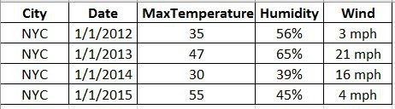
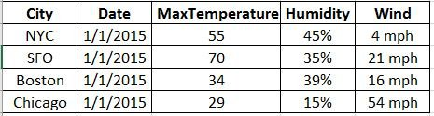
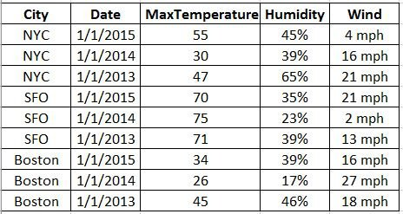
Data Types: Examples
Time-series data
Cross-sectional data
Max Temperature, Humidity and Wind in New York City (single entity) collected on First day of every year(multiple intervals of time).
Max Temperature, Humidity and Wind in New York City, SFO, Boston, Chicago(multiple entities) on 1/1/2015(single instance)
Panel data
Max Temperature, Humidity and Wind in New York City, SFO, Boston, Chicago(multiple entities) on First day of every year(multiple intervals of time)

Slide 5
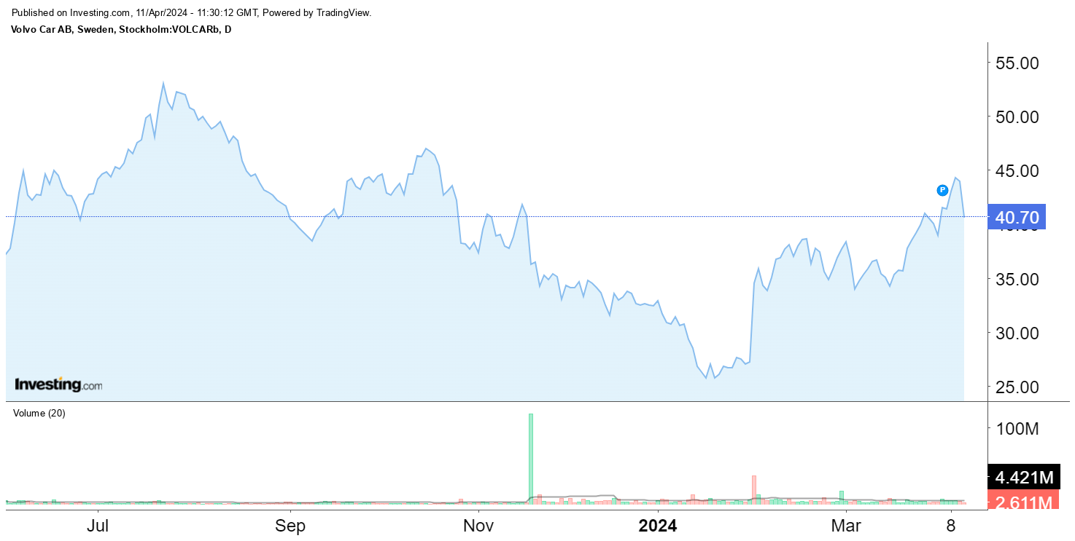
Examples of Time Series Data
Stock Prices: Daily closing prices of a company's stock over several months or years.

Slide 6
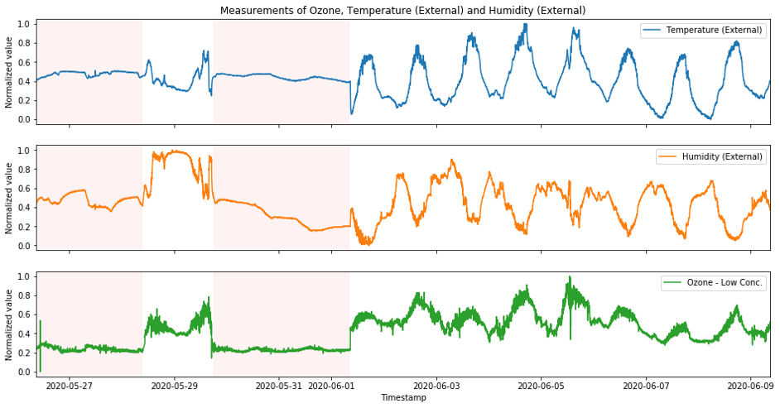
Examples of Time Series Data
Weather Data: Daily temperature readings, humidity levels, or precipitation amounts recorded over time.

Slide 7
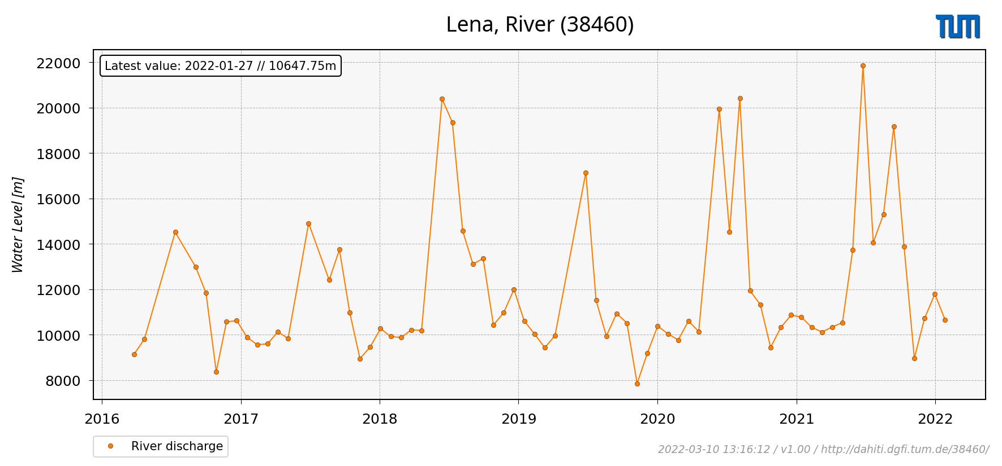
Examples of Time Series Data
Sensor Readings: Continuous measurements from sensors, such as IoT devices, tracking parameters like water level, pressure, or motion over time.

Slide 8
Characteristics of Time Series Data
Most time series can be decomposed in three major components.
Trend:
Trend refers to the long-term movement or directionality in the data.
It shows whether the variable is increasing, decreasing, or staying constant over time.
Example: A stock price showing an upward trend over several months shows growth in value.
Seasonality:
Seasonality reflects periodic patterns in the data that occur at regular intervals, such as daily, weekly, monthly, or yearly cycles.
Example: Retail sales often exhibit seasonality, with increased sales during holiday seasons.
Noise:
Noise represents random variations or irregularities in the data that are not related to the underlying trend or seasonality.
Example: Fluctuations in stock prices due to unexpected events can introduce noise into data.

Slide 9
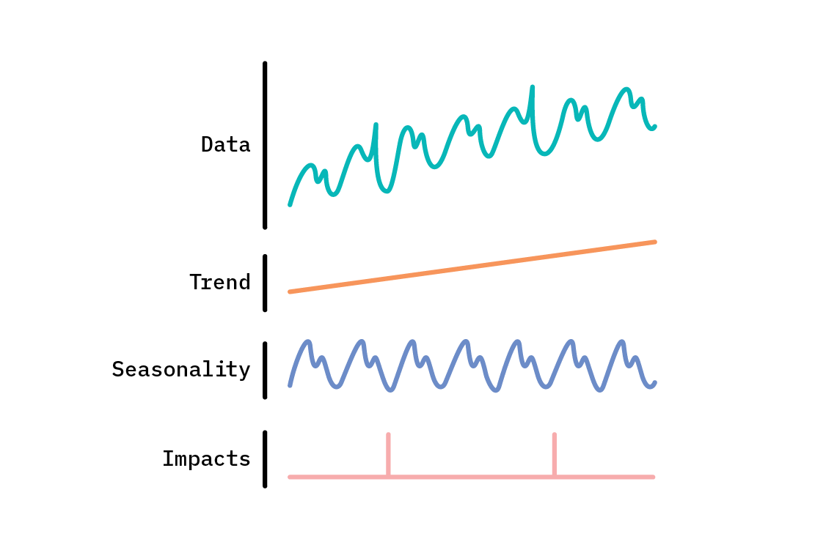
Characteristics of Time Series Data
Data
directionality in the data
Trend
Seasonality
periodic patterns
Noise
irregularities

Slide 10
Importance of Time Series Analysis
Time series analysis can be divided into two primary tasks:
Predictive Analytics
Time series analysis enables predictive modeling and forecasting, allowing businesses to anticipate future trends and make informed decisions.
Examples: Predicting stock prices, weather forecasts, demand forecasting for products.
Pattern Recognition
By analyzing historical time series data, patterns, anomalies, and recurring behaviors can be identified, leading to valuable insights and actionable strategies.
Examples: Identifying seasonal sales trends, detecting anomalies in sensor data for predictive maintenance.

Slide 11
Time Series Forecasting
Time series forecasting is the process of predicting future values or events based on historical data points collected at regular time intervals.
Key Components of Time Series Forecasting:
Time Series Data: Sequential observations or measurements recorded at regular intervals.
Forecast Horizon: Time period into the future for which predictions are made.
Forecasting Model: Statistical or machine learning methods for generating forecasts.
Evaluation Metrics: Measures used to assess the accuracy and reliability of forecasts.

Slide 12
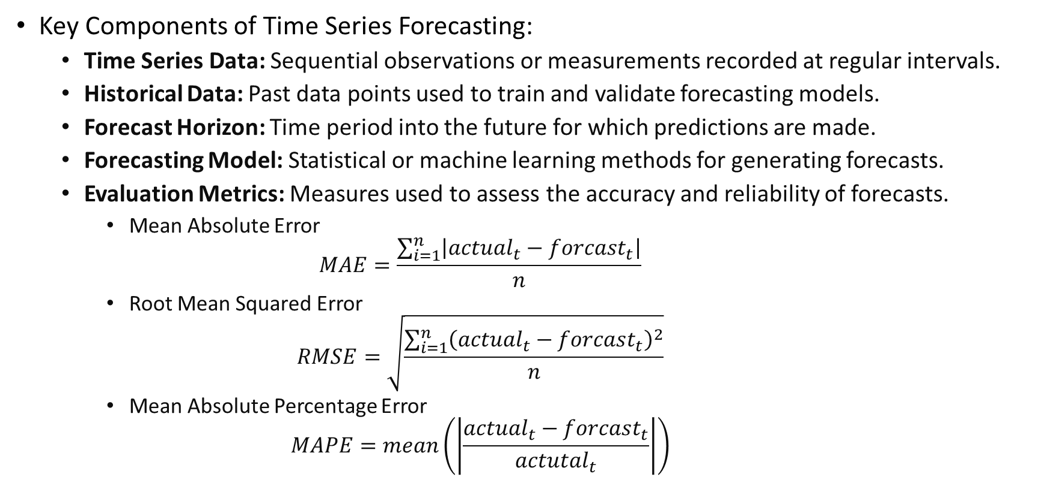
Time Series Forecasting
Key Components of Time Series Forecasting:
Time Series Data: Sequential observations or measurements recorded at regular intervals.
Historical Data: Past data points used to train and validate forecasting models.
Forecast Horizon: Time period into the future for which predictions are made.
Forecasting Model: Statistical or machine learning methods for generating forecasts.
Evaluation Metrics: Measures used to assess the accuracy and reliability of forecasts.
Mean Absolute Error
$$MAE=\frac{\sum_{i=1}^{n}{\left|actual_{t}−forcast_{t}\right|}}{n}$$
Root Mean Squared Error
$$RMSE=\sqrt{\frac{\sum_{i=1}^{n}{{\left(actual_{t}−forcast_{t}\right)}^{2}}}{n}}$$
Mean Absolute Percentage Error
$$MAPE=mean\left(\left|\frac{actual_{t}−forcast_{t}}{actutal_{t}}\right|\right)$$

Slide 13
ML Methods for Time Series Forecasting
ML models can be categorized into two groups based on the independent variable:
Univariate time series:
focuses on a single variable or observation over time.
In univariate time series analysis, the historical values of the variable itself are used to predict future values.
Examples: analyzing stock prices, temperature trends, or monthly sales figures.
Multivariate time series:
involves analyzing and forecasting multiple variables simultaneously, where each variable is measured or recorded over time.
considers the interrelationships and dependencies between multiple variables across time steps.
Examples: analyzing economic indicators (e.g., GDP, inflation rates), weather forecasting (using variables like temperature, humidity, and pressure), or analyzing sensor data from IoT devices (multiple sensor readings over time).

Slide 14
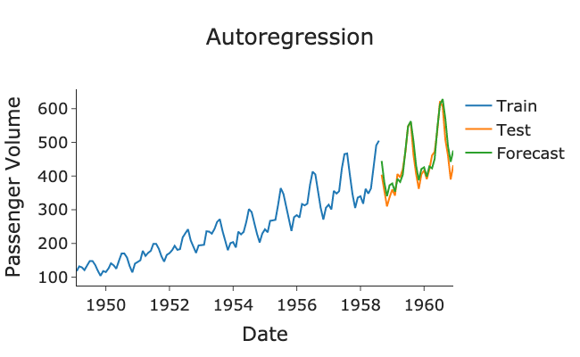
ML Methods for Time Series Forecasting
ML models can be categorized based on their types:
Autoregression-based models: They are regression models that use past values of a time series variable to predict future values, incorporating the time element into the modeling.
Autoregressive Moving Average (ARMA) Model
Autoregressive Integrated Moving Average (ARIMA) Model
Seasonal Autoregressive Integrated Moving Average (SARIMA) Model
Vector Autoregression (VAR) Model
Vector Autoregression Moving-Average (VARMA) Model
Etc.

Slide 15
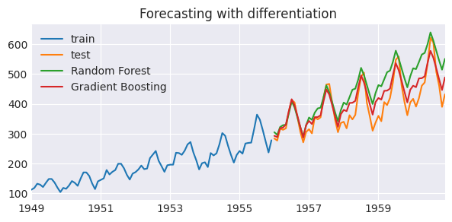
ML Methods for Time Series Forecasting
ML models can be categorized based on their types:
Ensemble learning-based methods:
Gradient Boosting Machines (GBM)
Decision tree and Random Forests (RF) for time series forecasting
XGBoost (Extreme Gradient Boosting)
AdaBoost

Slide 16

ML Methods for Time Series Forecasting
ML models can be categorized based on their types:
Exponential Smoothing-based methods: They use weighted averages of past observations and previous forecasts to generate forecasts for future time periods.
Simple Exponential Smoothing (SES)
$$y^{t+1}=αy^{t}+\left(1−α\right){\hat{y}}^{t}$$

Slide 17
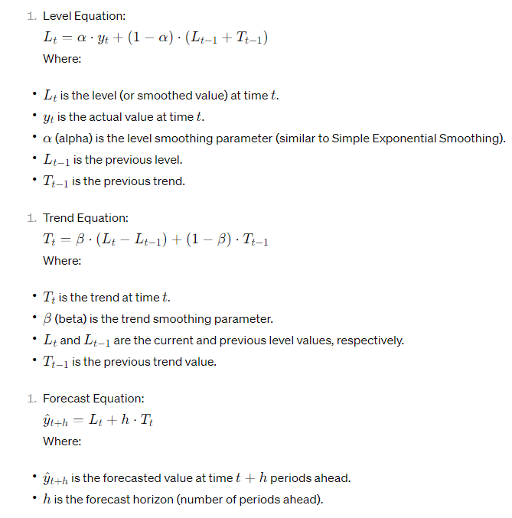
ML Methods for Time Series Forecasting
ML models can be categorized based on their types:
Exponential Smoothing-based methods: They use weighted averages of past observations and previous forecasts to generate forecasts for future time periods.
Simple Exponential Smoothing (SES)
Double Exponential Smoothing (Holt's Method)
Taken from: Wikipedia

Slide 18
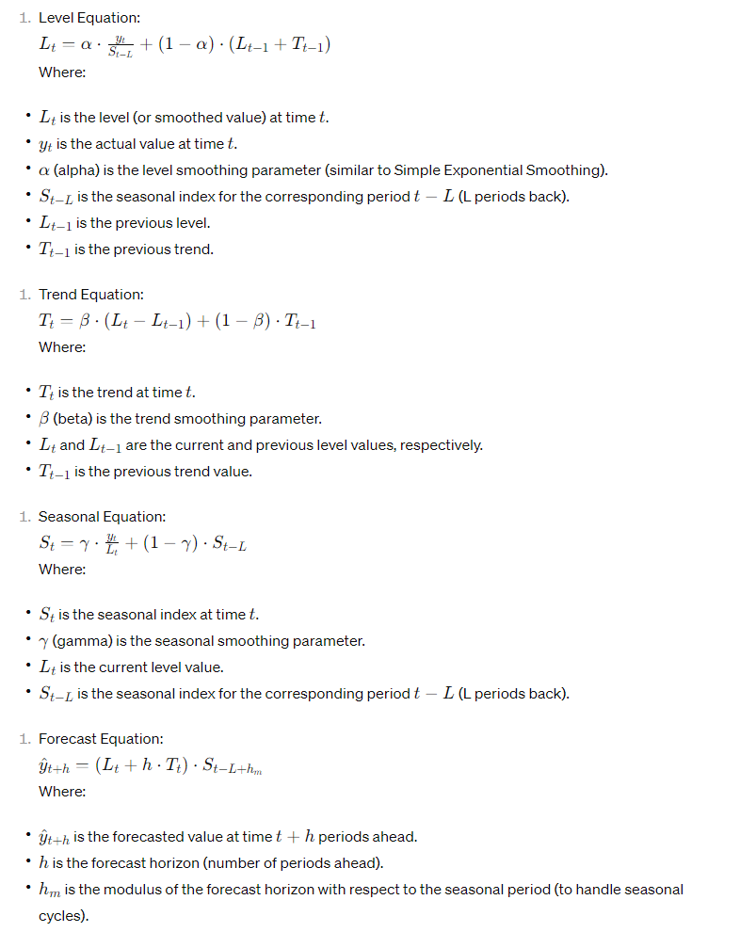
ML Methods for Time Series Forecasting
ML models can be categorized based on their types:
Exponential Smoothing-based methods: They use weighted averages of past observations and previous forecasts to generate forecasts for future time periods.
Simple Exponential Smoothing (SES)
Double Exponential Smoothing (Holt's Method)
Triple Exponential Smoothing (Holt-Winters' Method)
Taken from: Wikipedia

Slide 19
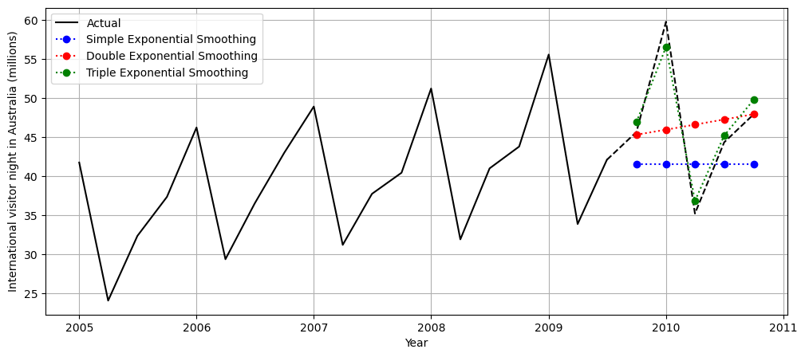
ML Methods for Time Series Forecasting
ML models can be categorized based on their types:
Exponential Smoothing-based methods: They use weighted averages of past observations and previous forecasts to generate forecasts for future time periods.
Simple Exponential Smoothing (SES)
Double Exponential Smoothing (Holt's Method)
Triple Exponential Smoothing (Holt-Winters' Method)

Slide 20
ML Methods for Time Series Forecasting
ML models can be categorized based on their types:
RNN-based models:
Recurrent Neural Network (RNN)
Gated Recurrent Unit (GRU) Network
Long Short-Term Memory (LSTM) Network
Other specialized methods:
Hidden Markov Models (HMM)
Kalman Filters
Facebook Prophet
Dynamic Linear Models (DLM)
Gaussian Process Regression

Slide 21
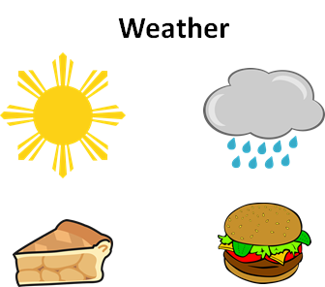
Recurrent Neural Networks
RNN is a type of artificial neural network which uses time series data.
In traditional neural networks, all the inputs and outputs are independent of each other.
Input
We might prepare different meals based on the weather:
Output
Apple Pie
Hemberger

Slide 22
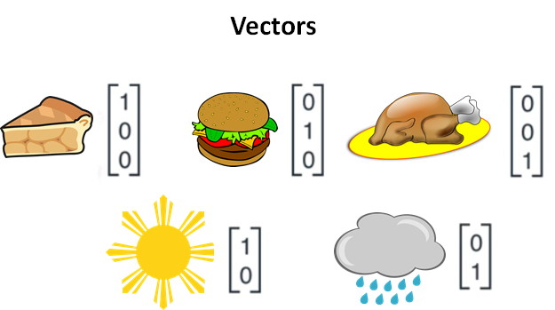
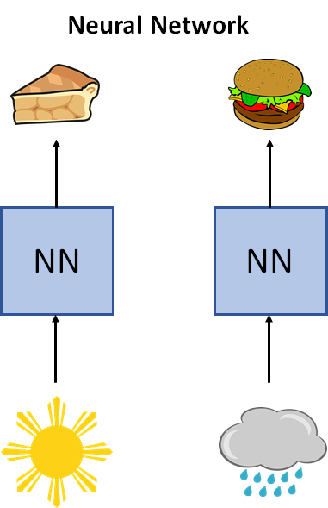
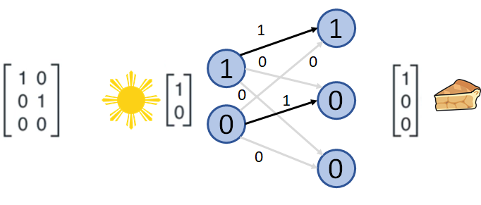
Recurrent Neural Networks
RNN is a type of artificial neural network which uses time series data.
In traditional neural networks, all the inputs and outputs are independent of each other.
Appropriate for image classification tasks, where input and output are independent.
Weight(s)

Slide 23
Recurrent Neural Networks
RNN is a type of artificial neural network which uses time series data.
In traditional neural networks, all the inputs and outputs are independent of each other.
Appropriate for image classification tasks, where input and output are independent.
Problem: When predicting the next data in a time series, it is necessary to have access to the previous samples in time.
This requirement arises from the need to remember the past data points.
Solution: RNN came into existence, which solved this issue with the help of a hidden layer.

Slide 24
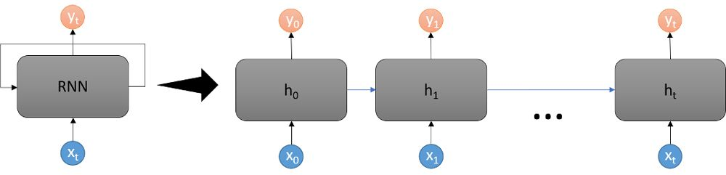

Recurrent Neural Networks
RNNs is a deep learning structure that uses past information to improve the performance of the network on current and future inputs.
The output of RNNs depend on the prior elements within the sequence.
predict the next element
$${ y}_{t+1}$$
$${ y}_{t+1}$$

Slide 25
Recurrent Neural Networks
In RNNs, the looping structure allows the network to store past information in the hidden state and operate on sequences.
How does the RNN know how to apply the past information to the current input?
The network has two sets of weights:
one for the hidden state vector and
one for the inputs.
During training, the network learns weights for both the inputs and the hidden state.
The output is based on the current input and the hidden state, which is based on previous inputs.

Slide 26
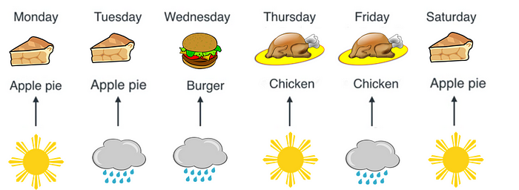


Recurrent Neural Networks
Example: we decide to cook based on what we cooked yesterday and the weather.
Sunny, we cook the same thing as yesterday.
Rainy, we cook the next food.
$$w_{h}$$
RNN
$$w_{input}$$

Slide 27
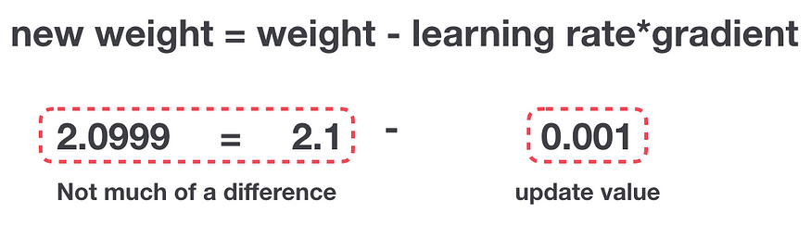
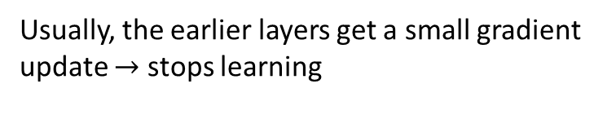
Challenges in Recurrent Neural Networks
Simple RNNs struggle to capture long-term dependencies in time series data.
When trying to include long memories, which involve considering many previous samples or time steps in the sequence, the gradients in the network can behave in undesirable ways.
Vanishing Gradient:
When gradients are backpropagated through many time steps in a simple RNN, they can become very small.
Consequently, the network has difficulty learning from distant past information, impacting its ability to capture long-term dependencies.
Usually, the earlier layers get a small gradient update $→$ stops learning
Gradient Update Rule

Slide 28
Challenges in Recurrent Neural Networks
When trying to include long memories, which involve considering many previous samples or time steps in the sequence, the gradients in the network can behave in undesirable ways.
Vanishing Gradient
Due to this, simple RNNs are limited in their ability to incorporate long memories into their computations.
This limitation is a significant drawback when dealing with tasks that require understanding context or relationships across long sequences of data.
Solution: Long Short-Term Memory (LSTM) networks address the challenges faced by simple RNNs.

Slide 29
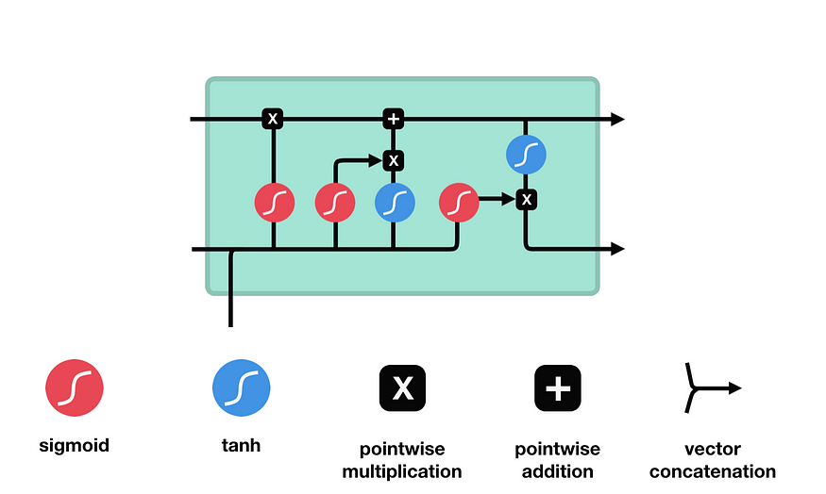
Long Short-Term Memory Networks
Long Short-Term Memory (LSTM) networks are a special kind of RNN.
They can remember information for long periods of time.
An LSTM has a similar control flow as an RNN.
It processes data passing on information as it propagates forward.
The differences are the operations within the LSTM’s cells.
Operations are used to allow LSTM to keep or forget information.
RNN
Cell state
LSTM
Hidden state
input

Slide 30
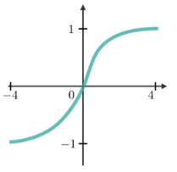
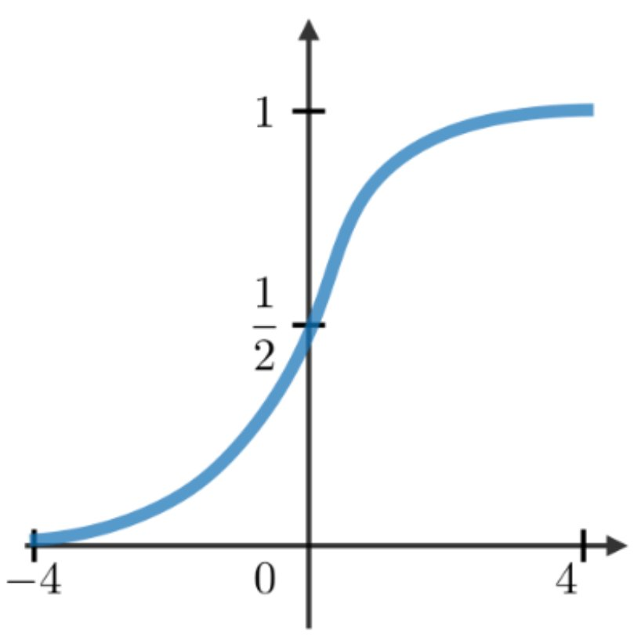



















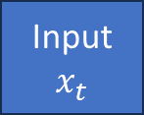




LSTM Architecture: Components
There are two states that are being transferred to the next cell; the cell state and the hidden state.
$$C_{t−1}$$
Cell State (long-term memory)
$$C_{t}$$
$$×$$
$$+$$
Output gate
Forget gate
Input gate
Input gate
Output gate
$$×$$
$$+b$$
$$+b$$
$$×$$
$$+b$$
$$+b$$
$${×w}_{h}$$
$$+$$
$${×w}_{h}$$
$$+$$
$${×w}_{h}$$
$$+$$
$${×w}_{h}$$
$$+$$
Hidden state $h_{t}$
$$h_{t−1}$$
$${×w}_{x}$$
$${×w}_{x}$$
$${×w}_{x}$$
$${×w}_{x}$$
Hidden state
short-term memory
The memory blocks are responsible for remembering things and manipulations to these memories are done through three major mechanisms, called gates.
Input
$$x_{t}$$

Slide 31
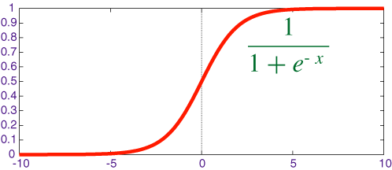

LSTM Architecture: Sigmoid Activation
Sigmoid activation function takes any x-axis coordinates and turns it into a y-axis coordinate between 0 and 1.
In LSTM, Sigmoids in forget, input, and output gates take same inputs ($h_{t−1}$, and $x_{t}$) and squash the outcomes between $[0,1]$.

Slide 32
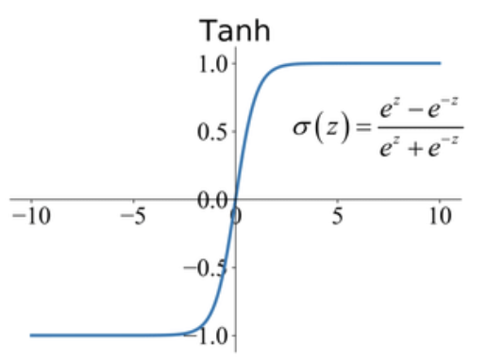

LSTM Architecture: Tanh Activation
Tanh activation function takes any x-axis coordinates and turns it into a y-axis coordinate between -1 and 1.
In LSTM, Tanh in input and gate takes same inputs ($h_{t−1}$, and $x_{t}$) and squash the outcomes between $[−1, 1]$.

Slide 33




LSTM Architecture: States
There are two states that are being transferred to the next cell; the cell state and the hidden state.
… and later by this summation
$$C_{t−1}$$
Cell State (long-term memory)
$$C_{t}$$
$$×$$
$$+$$
Long term memory can be modified by this multiplication
There are no weights and biases that can be modified directly.
The lack of weights allows long-term memory to follow through series of units without causing the gradients to explode or vanish.

Slide 34





LSTM Architecture: States
There are two states that are being transferred to the next cell; the cell state and the hidden state.
This line is called hidden state, represents the short-term memory.
$${×w}_{h}$$
$${×w}_{h}$$
$${×w}_{h}$$
$${×w}_{h}$$
$$h_{t−1}$$
The short-term memories are directly connected to weights that can modify them.

Slide 35



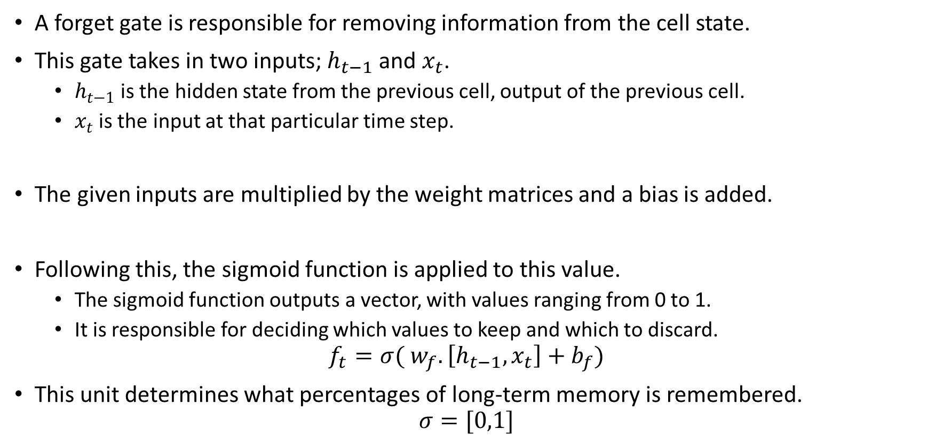




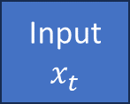

LSTM Architecture: Forget Gate
Forget gate
A forget gate is responsible for removing information from the cell state.
This gate takes in two inputs; $h_{t−1}$and$x_{t}$.
$h_{t−1}$is the hidden state from the previous cell, output of the previous cell.
$x_{t}$is the input at that particular time step.
The given inputs are multiplied by the weight matrices and a bias is added.
Following this, the sigmoid function is applied to this value.
The sigmoid function outputs a vector, with values ranging from 0 to 1.
It is responsible for deciding which values to keep and which to discard.
$$f_{t}=σ( w_{f}.\left[h_{t−1},x_{t}\right]+b_{f})$$
This unit determines what percentages of long-term memory is remembered.
$$σ=[0,1]$$
$$C_{t−1}$$
$$×$$
% long-term to remember
$$f_{t}$$
$$+b$$
$${×w}_{h}$$
$$+$$
$$h_{t−1}$$
$${×w}_{x}$$
Input
$$x_{t}$$

Slide 36


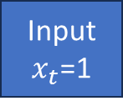



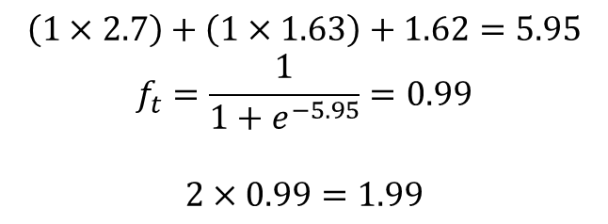




LSTM Architecture: Forget Gate
Forget gate
$$C_{t−1}=2$$
$$c_{t}^{mul}=1.99$$
$$×$$
% long-term to remember
$$f_{t}=0.99$$
$$\left(1×2.7\right)+\left(1×1.63\right)+1.62=5.95$$
$$f_{t}=\frac{1}{1+e^{−5.95}}=0.99$$
$$2×0.99=1.99$$
$$+b=1.62$$
$w_{h}$=2.7
$$+$$
Reduced the long-term memory by a little bit.
$$h_{t−1}=1$$
$${×w}_{x}=1.63$$
Input
$x_{t}$=1

Slide 37

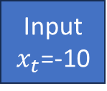

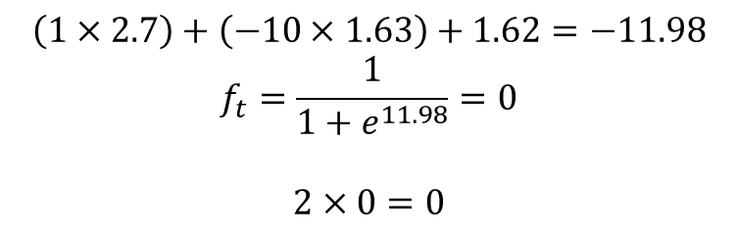
LSTM Architecture: Forget Gate
Forget gate
$$C_{t−1}=2$$
$c_{t}^{mul}=0$
$$×$$
% long-term to remember
$$f_{t}=0$$
$$\left(1×2.7\right)+\left(−10×1.63\right)+1.62=−11.98$$
$$f_{t}=\frac{1}{1+e^{11.98}}=0$$
$$2×0=0$$
$$+b=1.62$$
$w_{h}$=2.7
$$+$$
long-term memory would be completely forgotten.
$$h_{t−1}=1$$
$${×w}_{x}=1.63$$
Input
$x_{t}$=-10

Slide 38










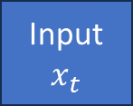


LSTM Architecture: Input Gate
$c_{t}^{mul}$
$$+$$
The input gate decides what new information to store in the cell state.
This addition of information is a three-step process:
Sigmoid gate: determines which parts of the current input are important or relevant.
Tanh gate: decides the potential impact of each piece of new information. Positive values: Positive impact, Negative values: negative impact, zero: neutral impact.
The input gate then combines these two pieces of information: the importance scores from the sigmoid gate and the potential new information from the tanh gate.
Input gate
Input gate
$$×$$
$$+b$$
$$+b$$
$${×w}_{h}$$
$$+$$
$${×w}_{h}$$
$$+$$
$$h_{t−1}$$
$${×w}_{x}$$
$${×w}_{x}$$
Input
$$x_{t}$$

Slide 39
LSTM Architecture: Input Gate
$c_{t}^{mul}$
$$+$$
The input gate decides what new information to store in the cell state.
The input gate then combines these two pieces of information: the importance scores from the sigmoid gate and the potential new information from the tanh gate.
This combination determines how much of the new information should be added to the cell state.
If the sigmoid gate scores are high for certain elements, and the corresponding values in the tanh gate are also significant, then those elements of the new information will strongly influence the cell state.
Input gate
Input gate
$$×$$
$$+b$$
$$+b$$
$${×w}_{h}$$
$$+$$
$${×w}_{h}$$
$$+$$
$$h_{t−1}$$
$${×w}_{x}$$
$${×w}_{x}$$
Input
$$x_{t}$$

Slide 40



















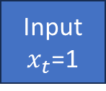




LSTM Architecture: Input Gate
We add 0.97 to the existing long-term memory.
$c_{t}^{mul}=1.99$
$$\tilde{c_{t}}=2.96$$
$$+$$
$$f_{s_{i}}=σ({W_{i}}_{s}.\left[h_{t−1}, x_{t}\right]+b_{i_{s}})$$
Rate of importance
$$f_{i}=0.97$$
Potential impact
$$f_{t_{i}}=0.97$$
$$f_{s_{i}}(4.27)=1$$
$$f_{s_{i}}=1$$
$$×$$
$$f_{t_{i}}=tanh({W_{i}}_{t}.\left[h_{t−1}, x_{t}\right]+b_{i_{t}})$$
$$+b=0.62$$
$+b$=-0.32
$$f_{t_{i}}(2.03)=0.97$$
$${×w}_{h}=2$$
$$+$$
$${×w}_{h}=1.41$$
$$+$$
$$h_{t−1}=1$$
$${×w}_{x}=1.65$$
$${×w}_{x}=0.94$$
$$f_{i}=f_{s_{i}}×f_{t_{i}}$$
$f_{i}=1×0.97$=0.97
Input
$x_{t}$=1
$$\tilde{c_{t}}=c_{t}^{mul}+f_{i}$$
$$\tilde{c_{t}}=1.99+0.97=2.96$$

Slide 41





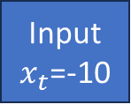
LSTM Architecture: Input Gate
$c_{t}^{mul}=0$
$$\tilde{c_{t}}=0$$
We would not add any new information to long-term memory.
$$+$$
Rate of importance
$$f_{i}=0$$
Potential impact
$$f_{t_{i}}=−1$$
$$f_{s_{i}}=0$$
$$×$$
$$+b=0.62$$
$+b$=-0.32
$${×w}_{h}=2$$
$$+$$
$${×w}_{h}=1.41$$
$$+$$
$$h_{t−1}=1$$
$${×w}_{x}=1.65$$
$${×w}_{x}=0.94$$
Input
$x_{t}$=-10

Slide 42



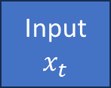
LSTM Architecture: Output Gate
The output gate decides which parts of the cell state​ will be used to compute the output current hidden state, which is the LSTM’s output.
The output gate in an LSTM uses:
a sigmoid unit to calculate the importance of both the current input and short-term memory.
a tanh unit to normalize the cell state values and facilitate stable learning by preventing the cell state from becoming too large or vanishing.
It combines these two pieces of information to determine the most relevant information for producing outputs based on the context of the current input sequence.
$$\tilde{C_{t}}$$
Output gate
Output gate
$$×$$
$$+b$$
$${×w}_{h}$$
$$+$$
Hidden state $h_{t}$
$${×w}_{x}$$
$$h_{t−1}$$
short-term memory
Input
$$x_{t}$$

Slide 43









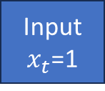







LSTM Architecture: Output Gate
$$\tilde{C_{t}}=2.96$$
$$f_{o_{s}}=σ(W_{o_{s}}.\left[h_{t−1},x_{t}\right]+b_{o_{s}})$$
Output gate
Output gate
$$f_{o_{s}}=0.99$$
$$f_{o_{s}}=0.99$$
$$f_{o_{t}}=0.99$$
$$f_{o_{t}}=tanh(\tilde{C_{t}})$$
$$×$$
$$f_{o_{t}}=0.99$$
$+b$=0.59
$${×w}_{h}=4.38$$
$$+$$
$$h_{t}=f_{o_{s}}×f_{o_{t}}$$
Hidden state $h_{t}=0.98$
$$h_{t−1}=1$$
$$h_{t}=0.98$$
${×w}_{x}$=-0.19
New short-term memory, which is output of LSTM
Input
$x_{t}$=1

Slide 44
Training and Tuning LSTMs:
Training an LSTM involves optimizing its parameters through a process called backpropagation through time.
The key elements in an LSTM include:
Weights and Biases: LSTM networks have various weights and biases associated with different gates (input gate, forget gate, output gate).
These parameters are learned during training to capture patterns in the input sequences.
Cell State and Hidden State: These are the internal states of the LSTM.
The cell state carries information across time steps, and the hidden state captures relevant information to produce outputs or predictions.
Both states are updated based on the input, previous states, and gate activations during training.
Loss Function: The choice of a loss function depends on the specific task (e.g., regression, classification) and guides the training process by quantifying the difference between predicted outputs and actual targets.

Slide 45
Training and Tuning LSTMs:
During training, the LSTM is fed input sequences, and the predictions are compared with the ground truth labels.
The optimization algorithm (e.g., stochastic gradient descent, Adam) adjusts the parameters iteratively to minimize the loss function and improve the model's predictive performance.
Regularization techniques like dropout or L2 regularization may also be used to prevent overfitting and improve generalization.
Overall, training an LSTM involves fine-tuning these parameters iteratively until the model learns to capture the underlying patterns and dependencies in the time-series data effectively.

Slide 46
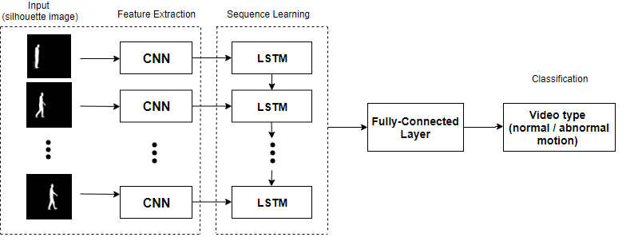
CNN-LSTM
A CNN-LSTM architecture combines Convolutional Neural Networks (CNNs) with LSTM networks to leverage the strengths of both models for tasks that involve sequential and spatial data, such as:
video analysis,
action recognition, and
time-series forecasting.

Slide 47
References
Joos Korstanje, Advanced Forecasting with Python: With State-of-the-Art-Models Including LSTMs, Facebook’s Prophet, and Amazon’s DeepAR, Apress, 2021.
Armin Lawi and Eka Kurnia, Accurately Forecasting Stock Prices using LSTM and GRU Neural Networks: A Deep Learning approach for forecasting stock price time-series data in groups, LAP, 2021.
Johannes Heinemann, Financial Time Series Forecasting using Neural Networks, ‎Independently published, 2021.
Mark Magic and John Magic, Action Recognition Step-by-step Recognizing Actions with Python and Recurrent Neural Network, Independently published, 2019.

Slide 48
Thank you for listening

